Slide 1


Immersive Python Workshop
January 7-9, 2026
Day 3
1/9/2026
Access shared notes
https://bit.ly/iwp-winter26-notes
UT-OSPO
UT Austin Open Source Program Office
Sloan grant number: G-2023-20944

Slide 2
Day 3 Schedule
12:30 PM | Welcome
12:40 PM | Divide into instruction tracks breakout rooms Geospatial Sentiment Analysis Data Visualization
1:30 PM | Break
1:40 PM | Continue work in separate tracks
2:30 PM | Break
2:40 PM | Instruction: GitHub and AI
3:55 PM | Complete Day 3 Assessment and Wrap Up

Slide 3
Final Check of Installed Software

Slide 4
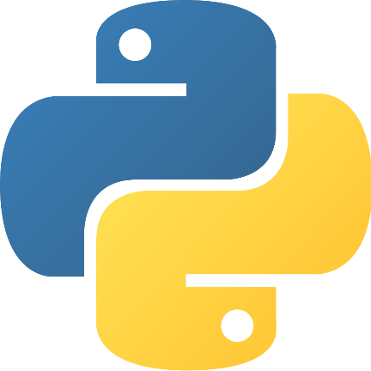
Python Software Installation Support
Mac users
All Macs with a recent version of MacOS already have Python 3 installed and you do not need to install a separate version of Python
Windows users
If you do not already have Python installed on your computer, visit https://www.python.org/downloads/ to install the latest version of Python 3

Slide 5
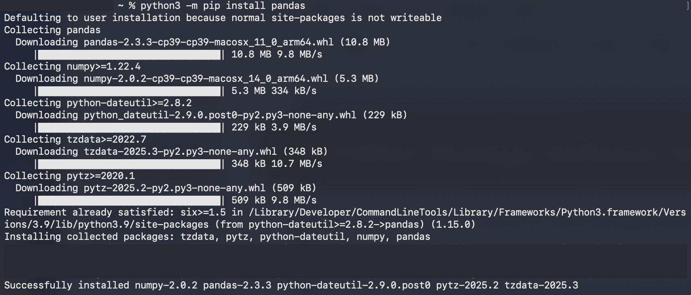
Python Package Software Installation Support
Make sure you can install new Python packages using the Terminal (MacOS) or Command Prompt (Windows) using the following example prompts:
The command on a Windows PC for installing the pandas package should be: python -m pip install pandas
The command on a Mac for installing the pandas package should be: python3 -m pip install pandas

Slide 6

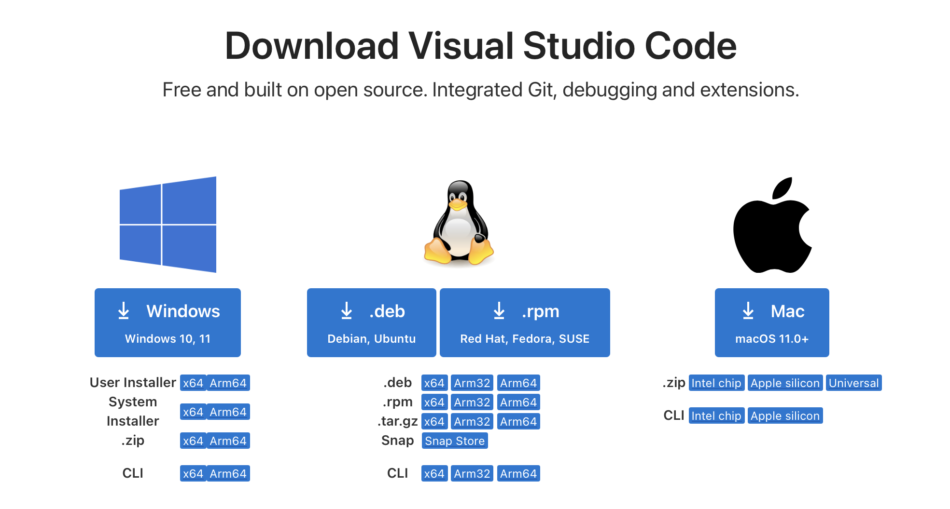
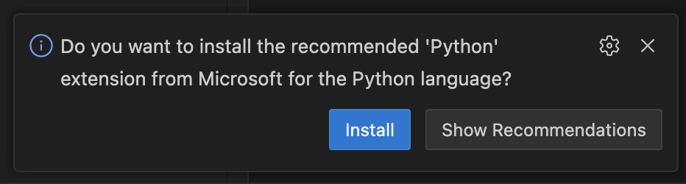
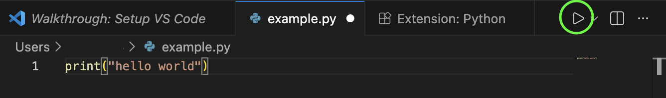
VSCode Software Installation Support
Visit https://code.visualstudio.com/download to download the VSCode installer for your system
Once the installation is complete, open VSCode on your computer to make sure it has been successfully set up
Create a new file with the extension .py (to designate the file as a Python script)
This should trigger the download of the Python extension if you do not have it in VSCode already
Try clicking the play/run button in the upper right corner of VSCode to run the script
For additional detail about the process for running Python scripts in VSCode, visit the Google Doc which describes how to verify your Python installation is correctly configured

Slide 7


GitHub Desktop Software Installation Support
The installation process for GitHub Desktop on Macs and Windows PCs is similar - just visit https://desktop.github.com/download/ to download the installer and load the software on your computer
Once GitHub Desktop is installed, make sure you can open it successfully
With GitHub Desktop open, log in to your GitHub.com account
If you do not already have a GitHub account, it would be good to set one up before the Immersive Python Workshop.

Slide 8
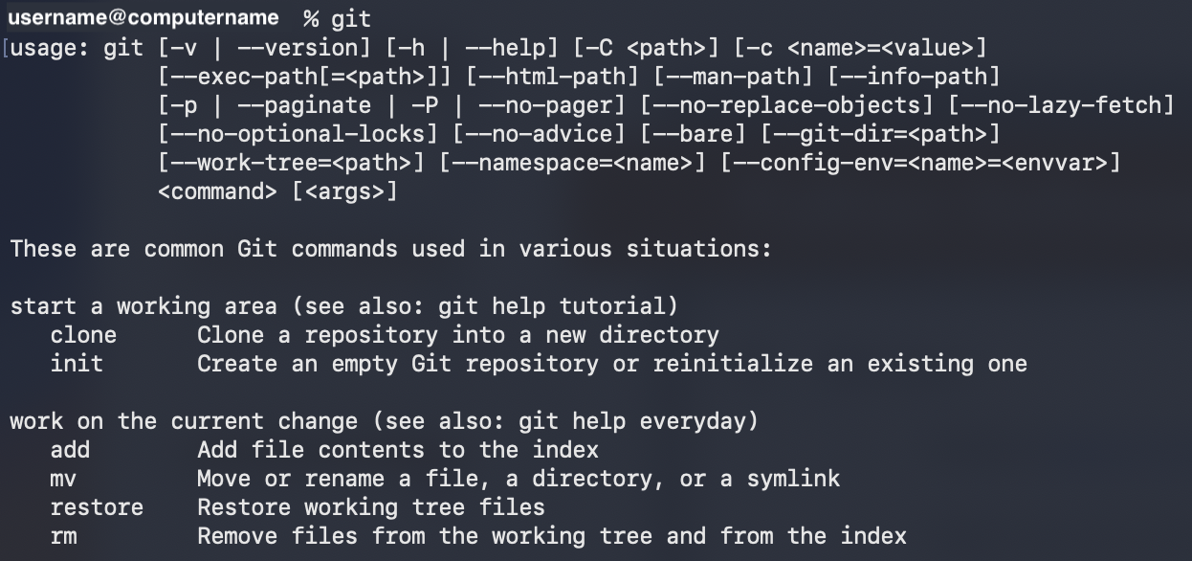
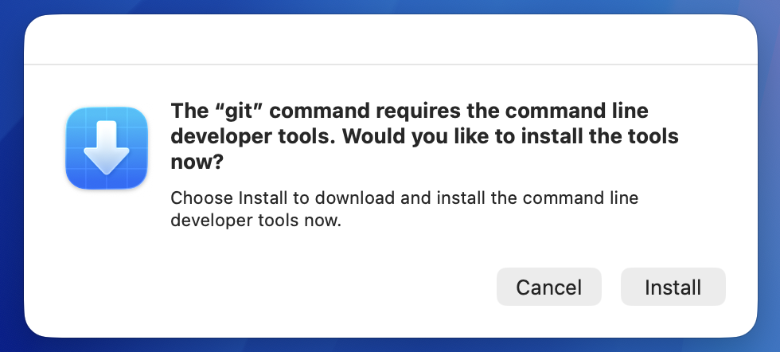
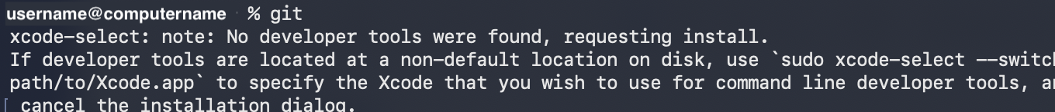
Git Software Installation Support
For Windows users, download the Git installer from: https://git-scm.com/downloads
For Mac users, open the Terminal on your computer and try running the git command
If you see a message that looks like the one below, you already have git installed and ready to use in the Terminal
If you see a message that looks like this one below in the Terminal and see the popup message below, you need to install git so it is accessible from your Terminal. You can do this by clicking “Install” in the popup window.

Slide 9
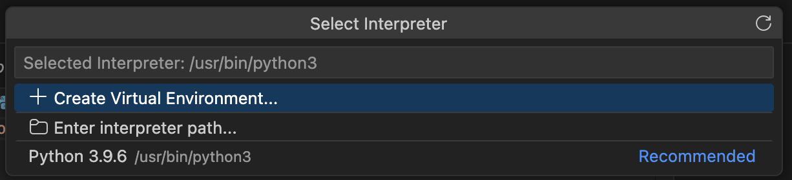
Common Software Installation Issues on Macs
ISSUE: you cannot run a Python script in VS Code
CAUSE: the Python default interpreter path is not set correctly
SOLUTION: In VSCode go to File > Preferences > Settings and search for the Python default interpreter path setting - when you find it, update the the value to the correct Python interpreter path which should be usr/bin/python3

Slide 10
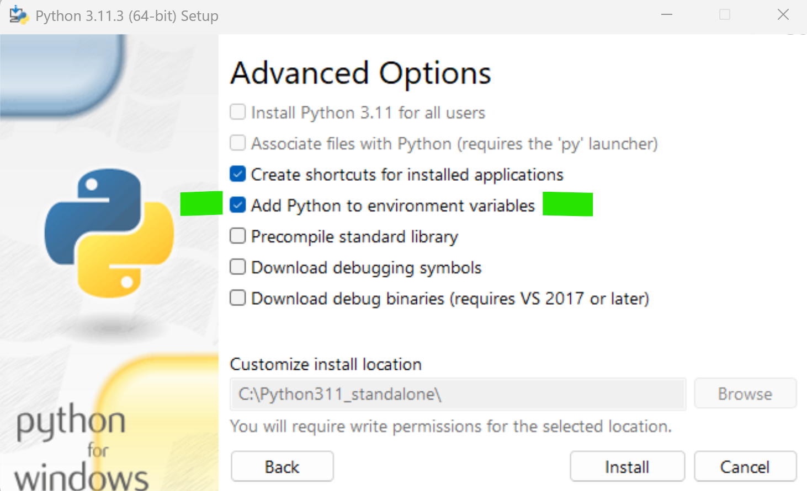
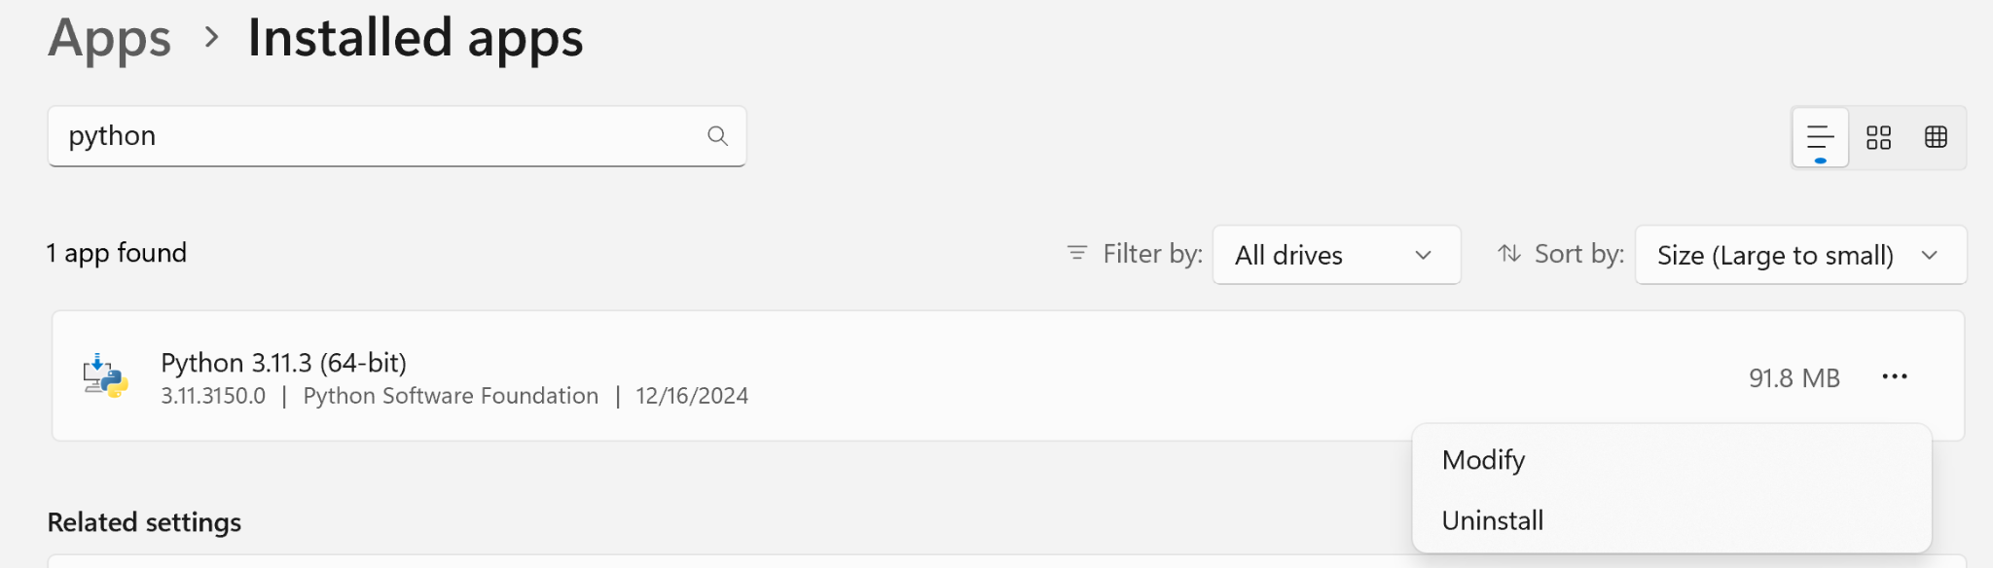
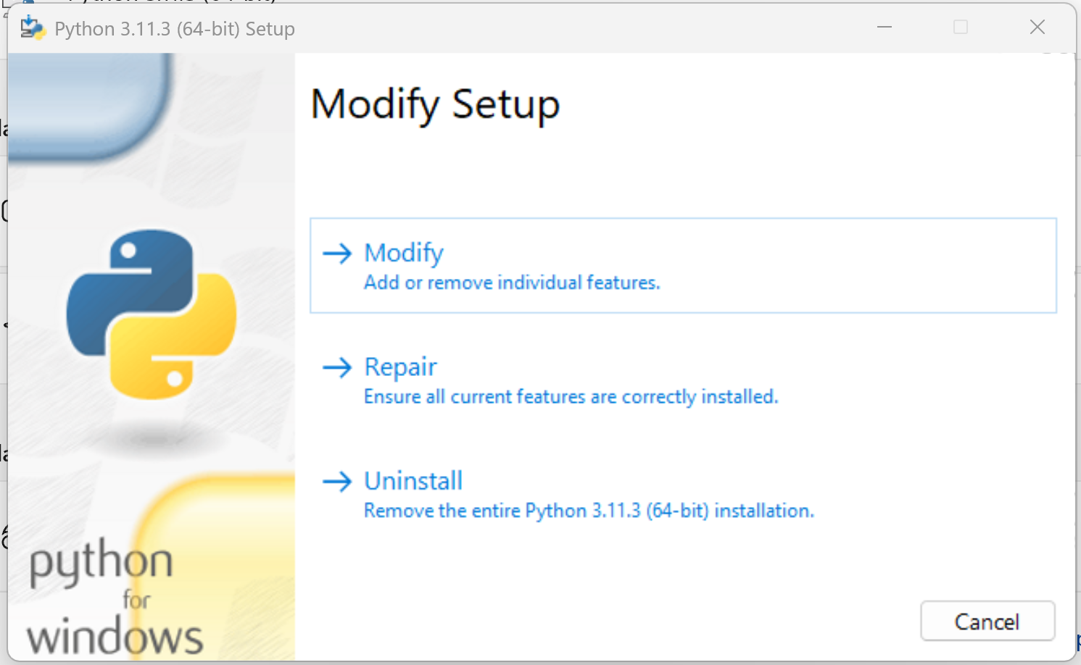
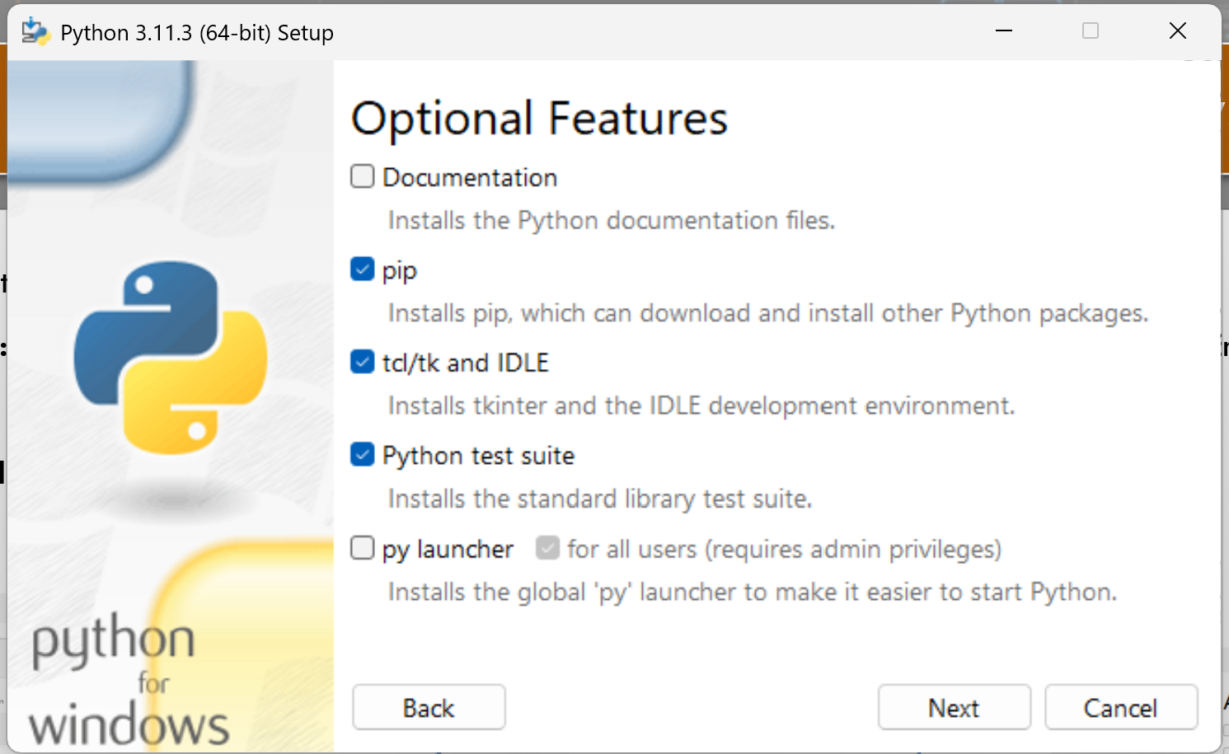
Common Software Installation Issues on Windows PCs
ISSUE: trying to python in the command prompt opens the Windows Store
CAUSE: the directory containing your Python interpreter is not correctly listed in your system Environment Variables’ path listing
SOLUTION: Go to Installed Apps in your Window Settings, click on Python, click Modify, click Next, then make sure the checkbox for “Add Python to environment variables” is selected and click Install. Now re-open the Command Prompt and type python to verify you can run Python using the command line.
1
2
3
4

Slide 11
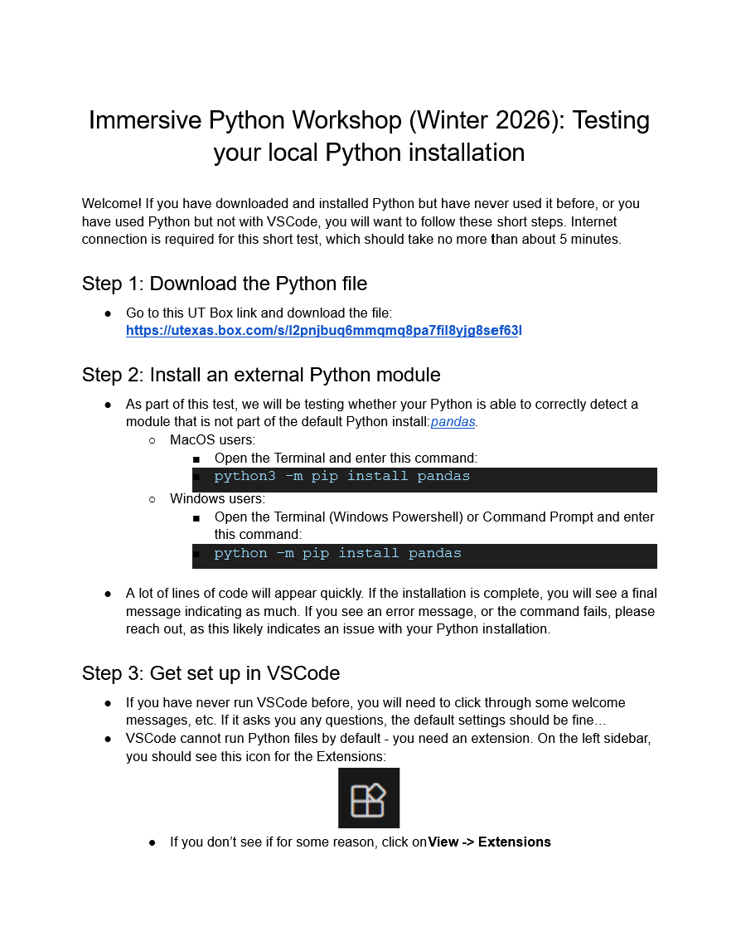
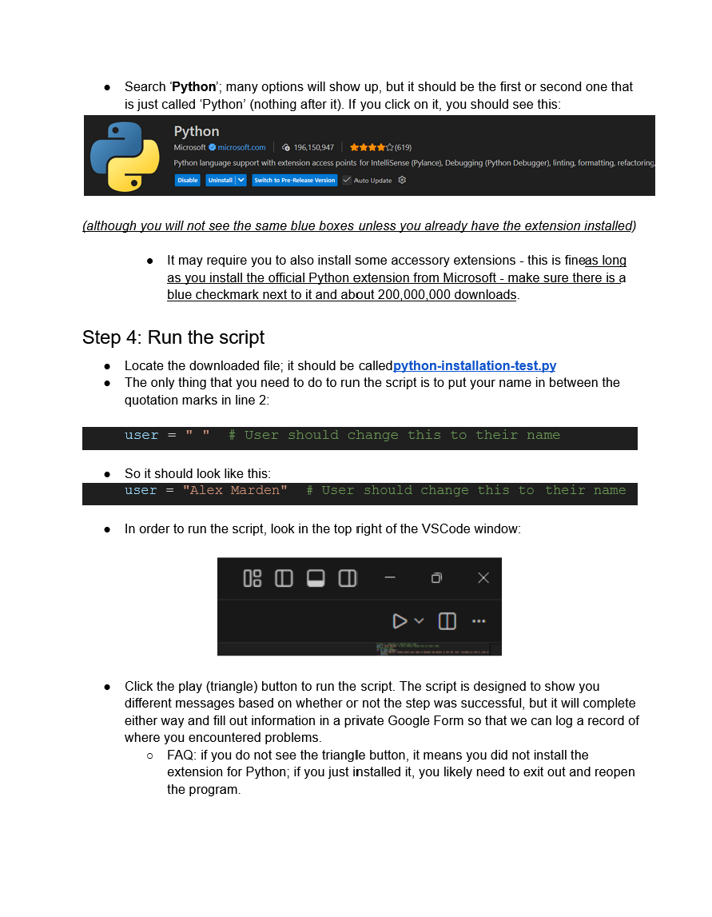
Verifying Everything is Installed and Configured Correctly
Review the instructions in this Google Doc which describe how to run a pre-prepared Python script that will check your computer to verify that all software required for the work is installed and configured correctly

Slide 12
Track 1
Topic:
Data Visualization
Instructor:
Michael Shensky
Track 2
Topic:
Sentiment Analysis
Instructor:
Ian Goodale
Track 3
Topic:
Geospatial Data
Instructor:
Alex Marden

